Slide 1
Title :- Tech Job Trends Analysis using Power BI
Subtitle :- Helping Job Seekers with Insights from Real Data
Presented By :- Subham Biswas

Slide 2
Title: Project Overview
Help job seekers by analyzing:
Hiring trends
High-paying industries
In-demand skills

Slide 3
Dataset Overview Source: Kaggle Format: Excel Key Columns: Job Title, Industry, Required Skills, Salary USD, Remote Friendly, AI Adoption Level, Automation Risk
Tools Used : Python (Pandas), Power BI, Excel, Git & GitHub

Slide 4
Step-by-Step Process : Download & clean dataset Segment by industry, title, and salary Extract and count required skills Visualize insights in Power BI
Key Power BI Visuals : Jobs by industry (bar chart) Avg salary by job title Top required skills (bar/word cloud) AI adoption & automation risk (pie) Remote jobs by industry

Slide 5
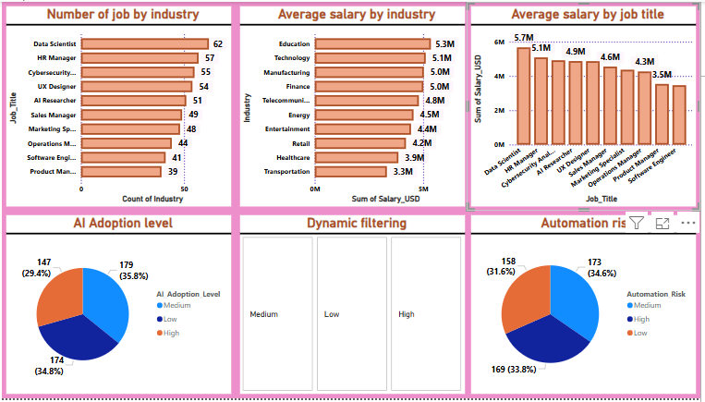
Power BI Dashboard Creation

Slide 6
Insights : Top-paying industries and job titles Most in-demand skills (e.g., Python, SQL) High AI adoption = higher salaries Remote jobs are growing in tech roles
Conclusion : Job seekers can use these insights to plan better Project can be extended to include trends over time Shared on GitHub with full code + dashboard

Slide 7
Title: Conclusion
Successfully developed a comprehensive dashboard for mobile analytics.
SQL queries and Power BI dashboards provide actionable insights.
The analysis supports strategic decision-making in the mobile retail sector.

Slide 8
THANK YOU !

